Slide 1


Online E-Commerce Vendor Verification System

Slide 2

Supervised by
Presented by
MD. KHALED SOHEL
Assistant Professor
Department of Software Engineering
Daffodil International University
AYESHA RAHMAN ORPA
182-35-2514
Department of Software Engineering
Daffodil International University

Slide 3

Why this system?
It will give the facilities to the vendors for getting the verification easily.
It is user friendly system.
This system will help to prevent identity fraud.
It will help to consume the time complexity.
Vendors can get the facility of re-application.

Slide 4

Overview
Online vendor verification system is the process by which the vendors will get their business verification certificate if they have legitimate documents.
Justifying the documents and giving the verification is the basic goal here.
User friendly system to be verified.

Slide 5

Goals
It will be a latest system for getting verified easily.
It will help people to save their time.
It will prevent the fraud problems.
There people can re-apply easily for their verification system.
If people face problem with this system they can easily live chat with emergency support officer.

Slide 6

Stakeholders
Police
Consumer
Emergency Support Officer

Slide 7

Features
A. Common Features:
Login/Logout.
Change password.
See verification status.
B. Consumer Features:
Register to the system.
Enlisting business for verification.
Download certification of successful verification.
Reapply for unverified business.
Live chat with emergency support officer.
C. Emergency Support Officer Features:
Replying consumers query.
Approve/Reject consumers registrations.
Add/Remove Police.
D. Police Features:
Verifying enlisted verification requests.
Review unverified verification requests.

Slide 8

Tools & Technology
HTML 5
NodeJS (RESTful api)
jQuery
Bootstrap 5
Font awesome
MySQL

Slide 9
Use Case

Slide 10
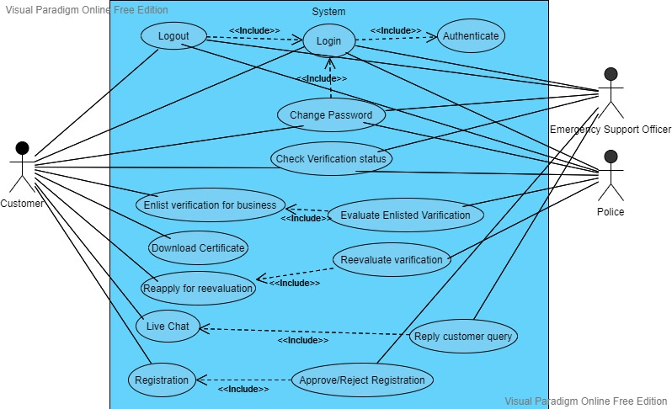

Slide 11
Activity Diagram

Slide 12
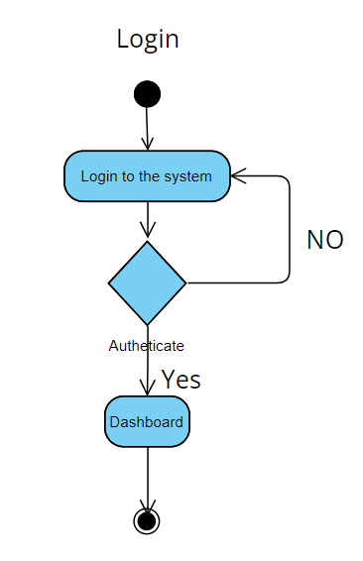

Slide 13
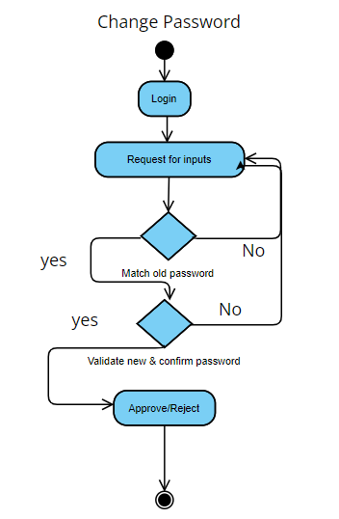
Apply changes

Slide 14
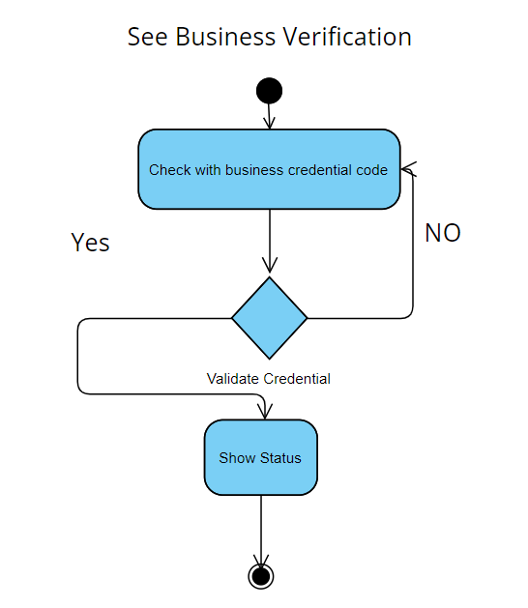

Slide 15
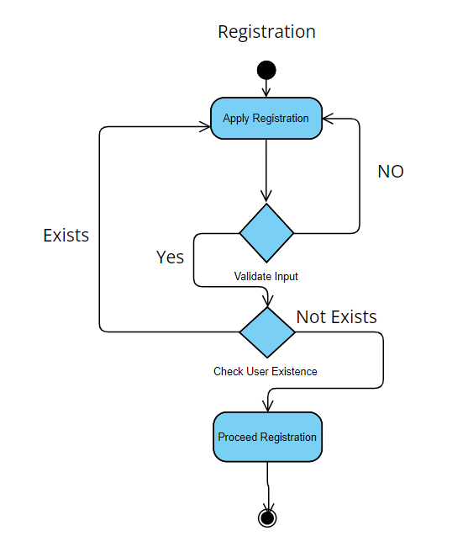

Slide 16
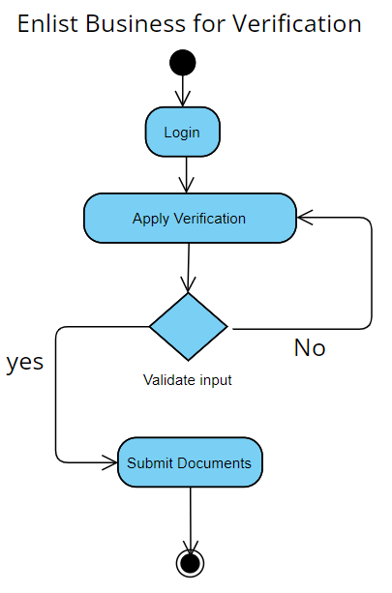

Slide 17
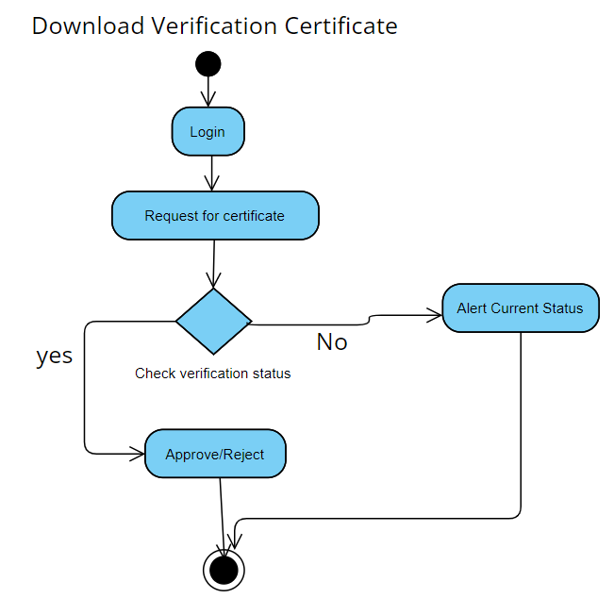
Download

Slide 18
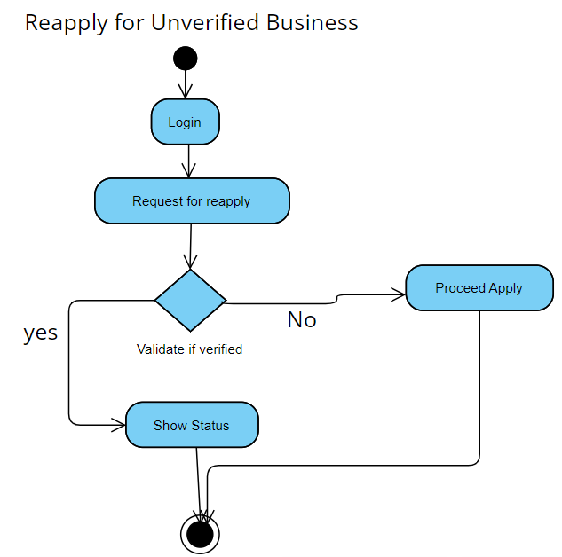

Slide 19
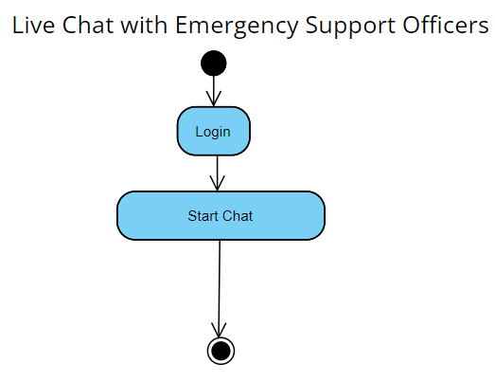

Slide 20
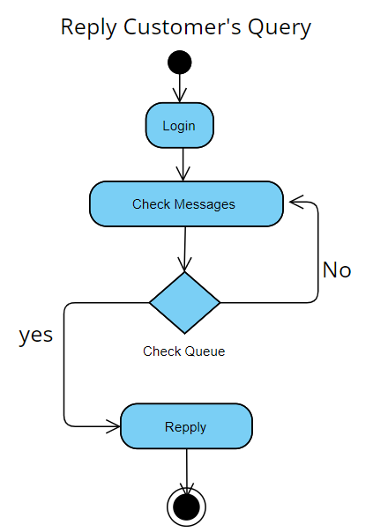

Slide 21
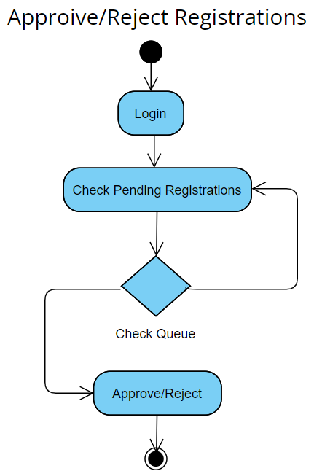
Yes
No

Slide 22
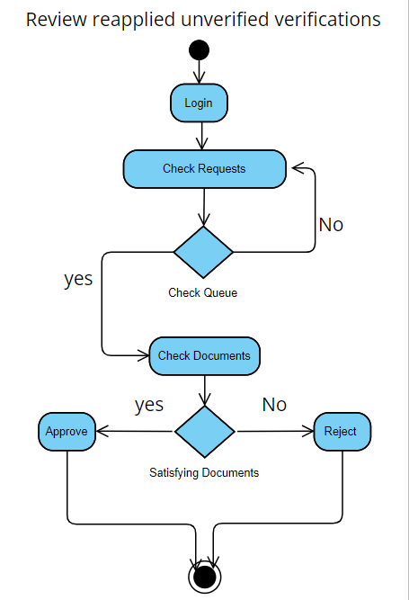
Verifying enlisted verification requests

Slide 23
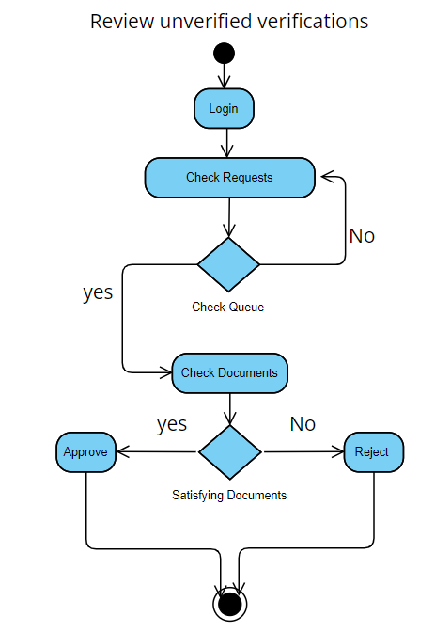

Slide 24
Sequence Diagram

Slide 25
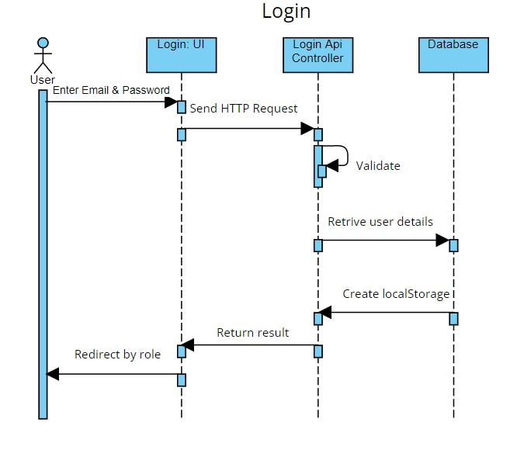

Slide 26
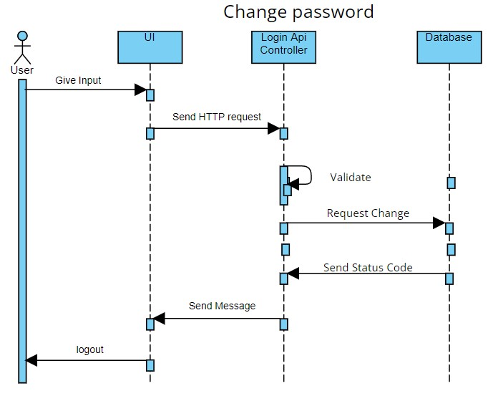

Slide 27
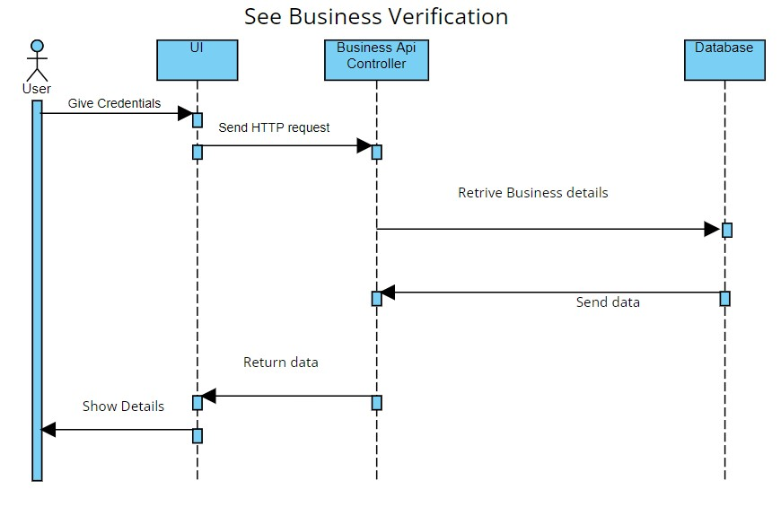

Slide 28
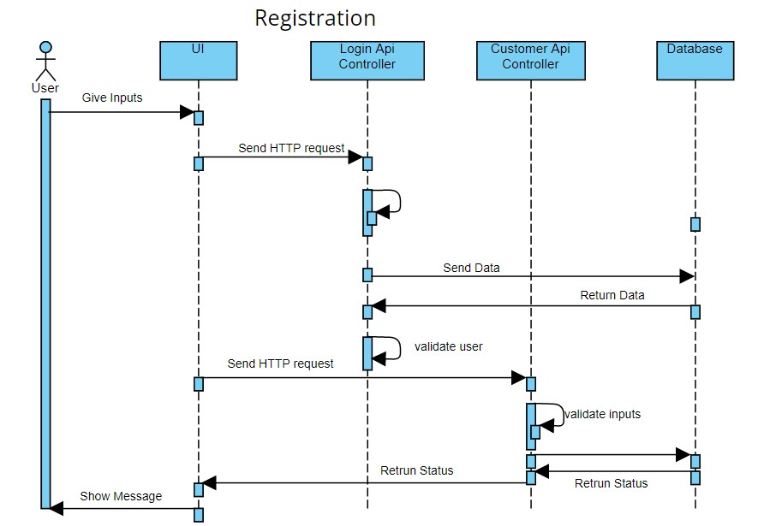
Validate input
Send Data

Slide 29
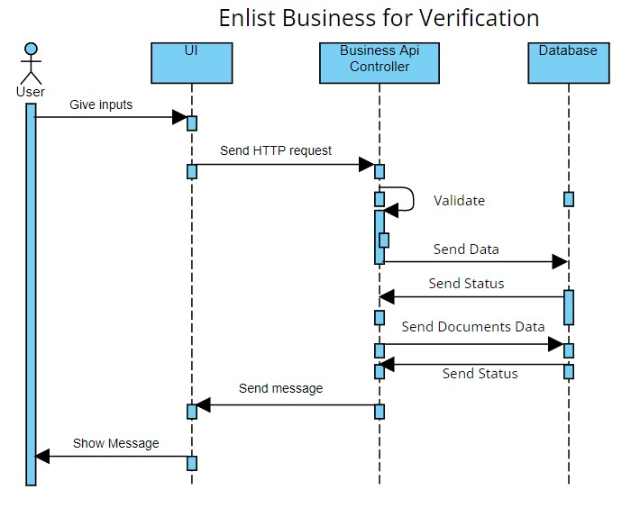

Slide 30
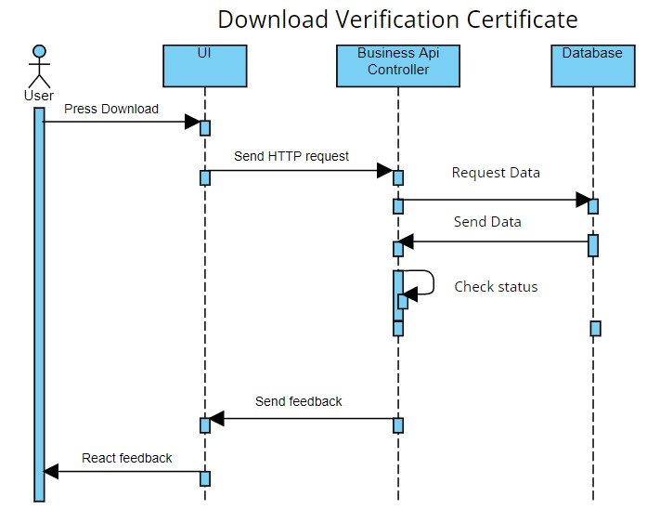

Slide 31
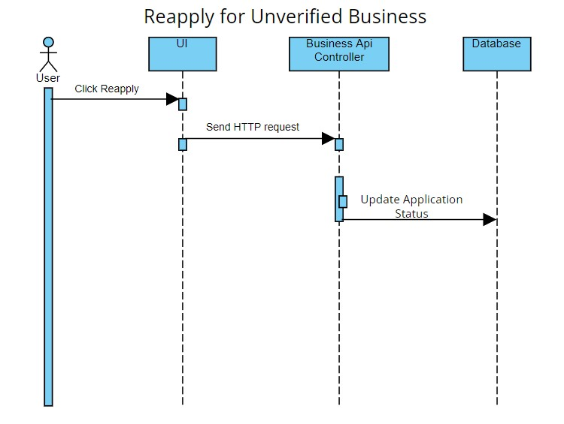

Slide 32
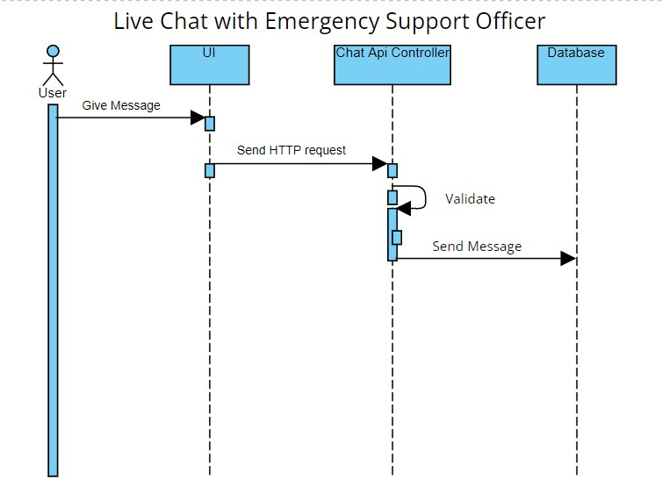

Slide 34
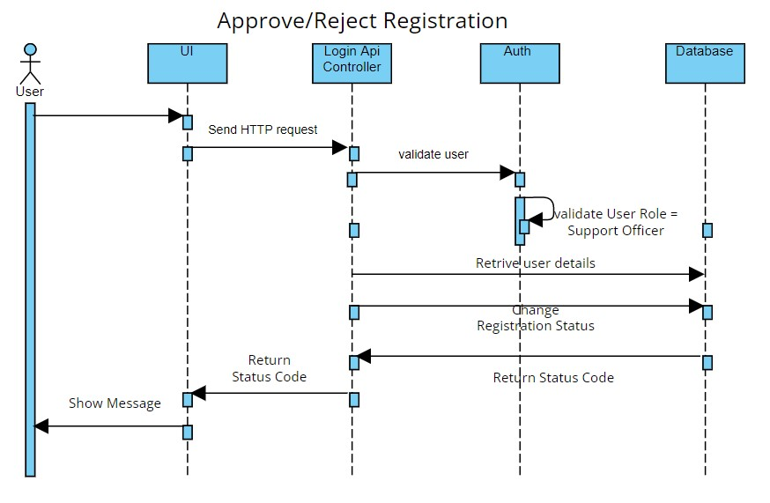
Give Input

Slide 35
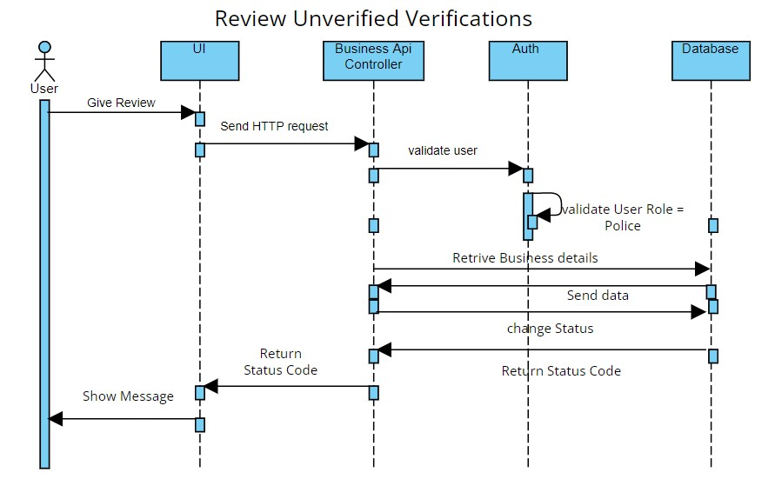

Slide 36
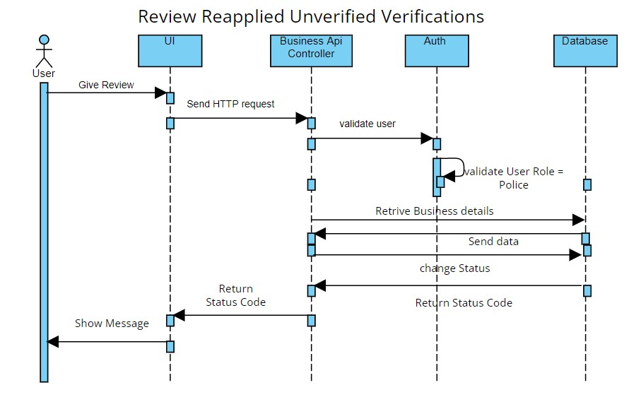

Slide 37
Class Diagram

Slide 38
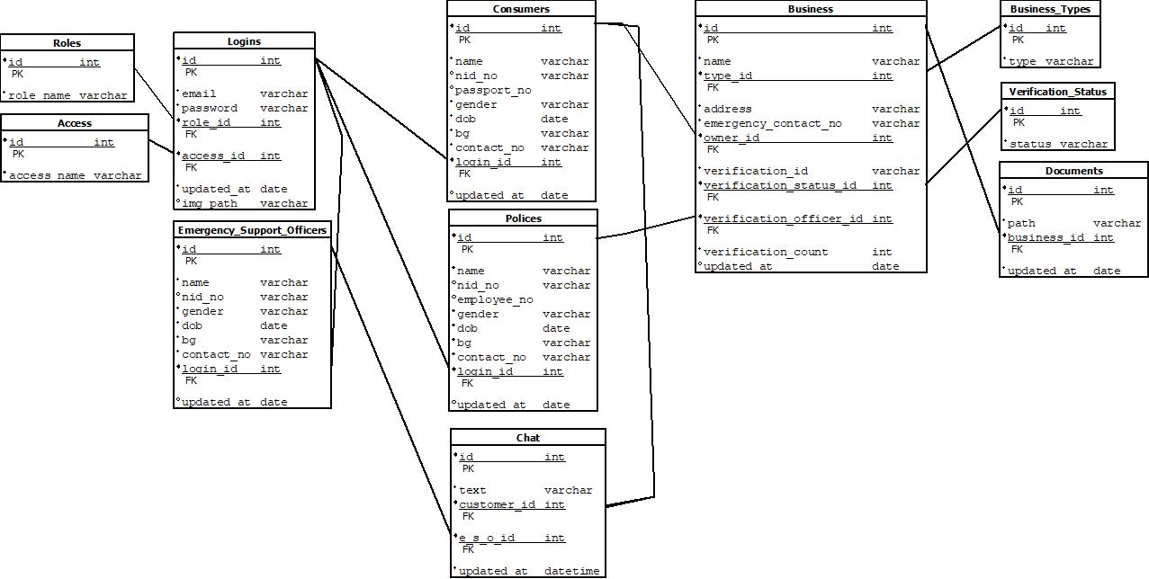

Slide 39
ER Diagram

Slide 40
